Slide 1
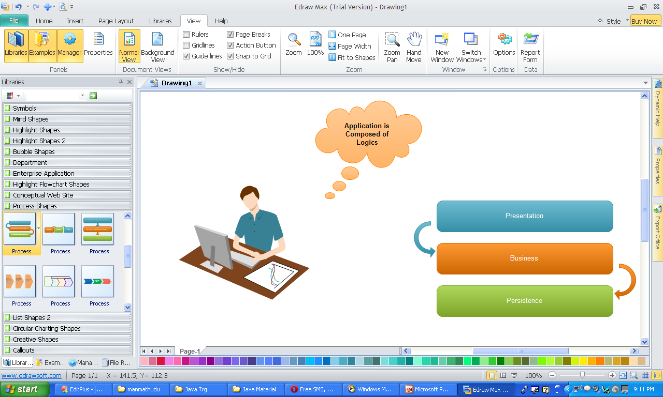

Slide 2
Single Tier Application
Client tier
Application Clients
Web Clients
+ Simple, Faster, Secured
- No N/W, Modification is Difficult, Data Lost is Lost

Slide 3
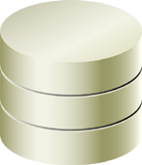
Two tiered Applications
Client tier
Application Clients
Web Clients
EIS tier

Slide 4

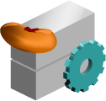


Distributed Multitiered Applications
Client tier
Application Clients
Web Clients
Servlets
JSP/JSF Pages
Web tier
Enterprise Beans
Web Services
Business tier
Entities
Persistence tier
EIS tier

Slide 5
Compile time environment Run time Environment
A.Java
B.Java
C.Java
A.class
B.class
C.class
Java compiler
JVM
Object.class
String.class
A.Class
B.Class
C.Class

Slide 6
JVM
Class loader
The Java API
class files
Your program
class files
Byte codes
Execution engine
Basic block diagram of the Java virtual machine

Slide 7
Class loader
Your program
class files
The Java API
class files
Byte codes
Execution engine
Native method invocations
Host operating system
A Java virtual machine implemented in software on top of a host operating system

Slide 8
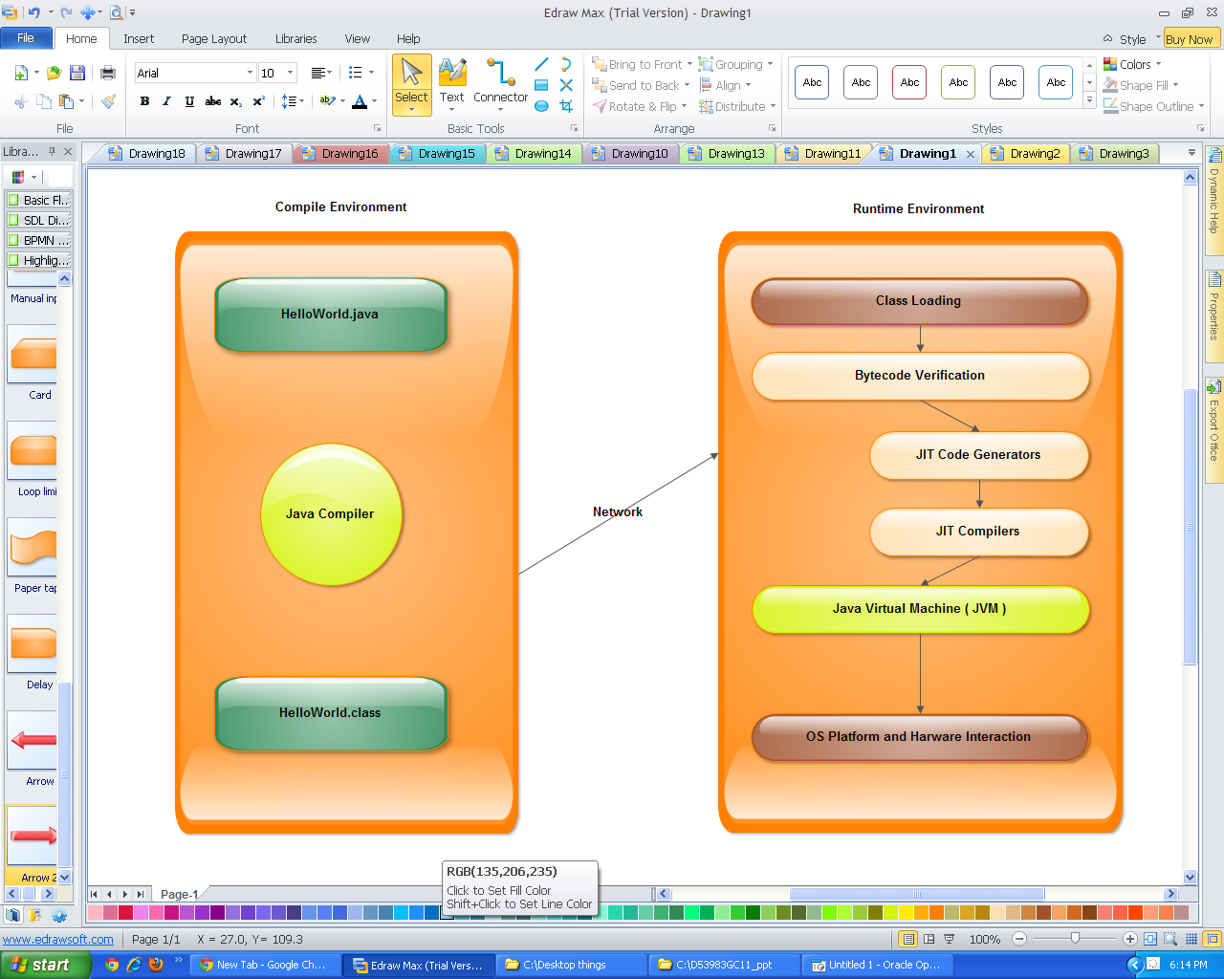

Slide 9
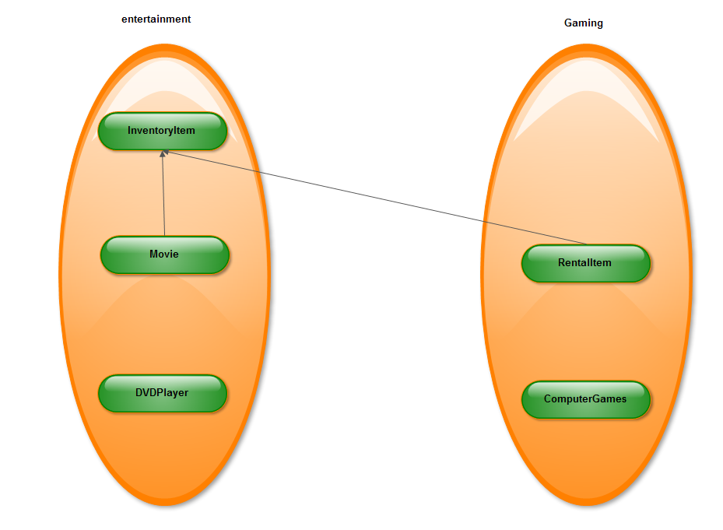

Slide 10
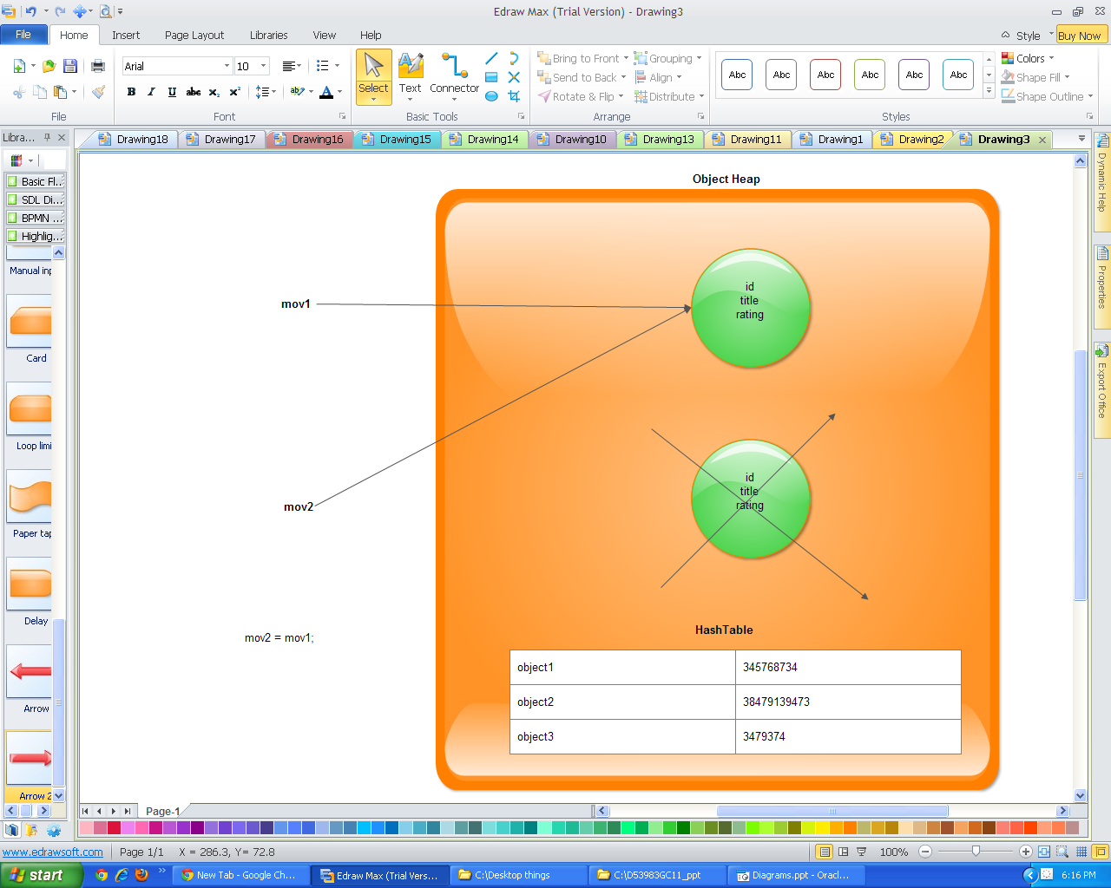

Slide 11
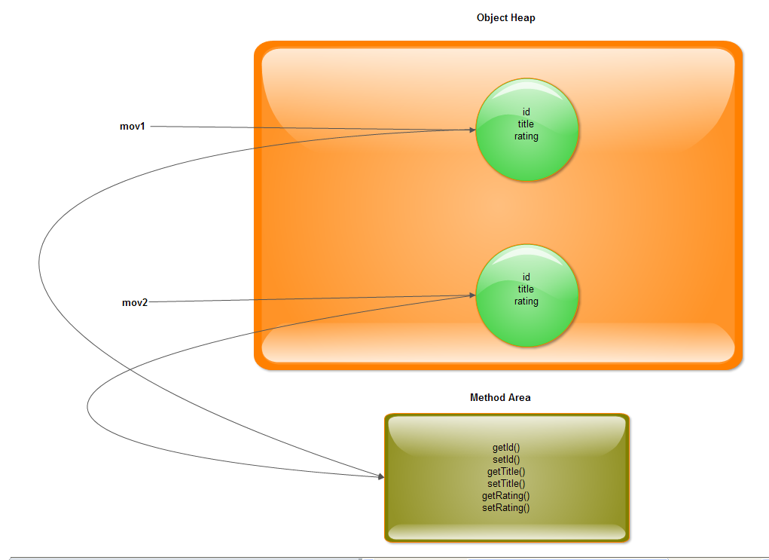

Slide 12
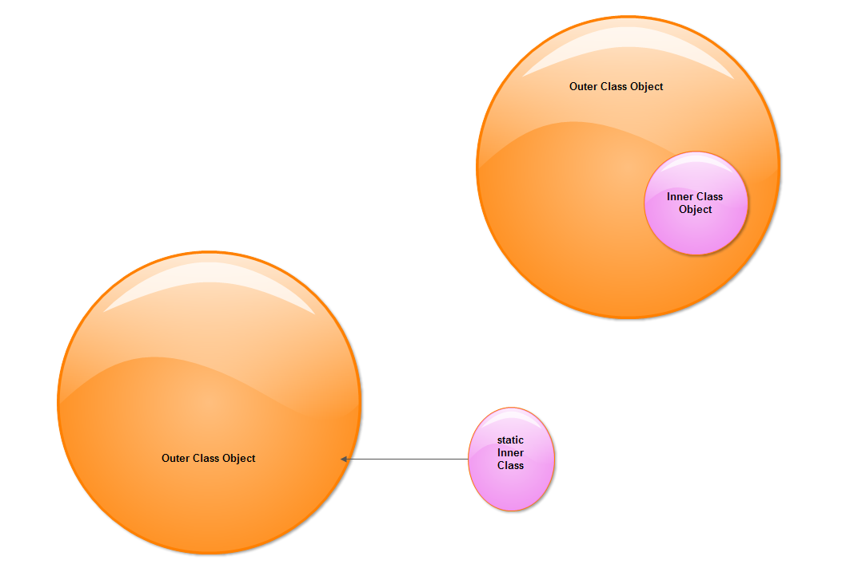

Slide 13
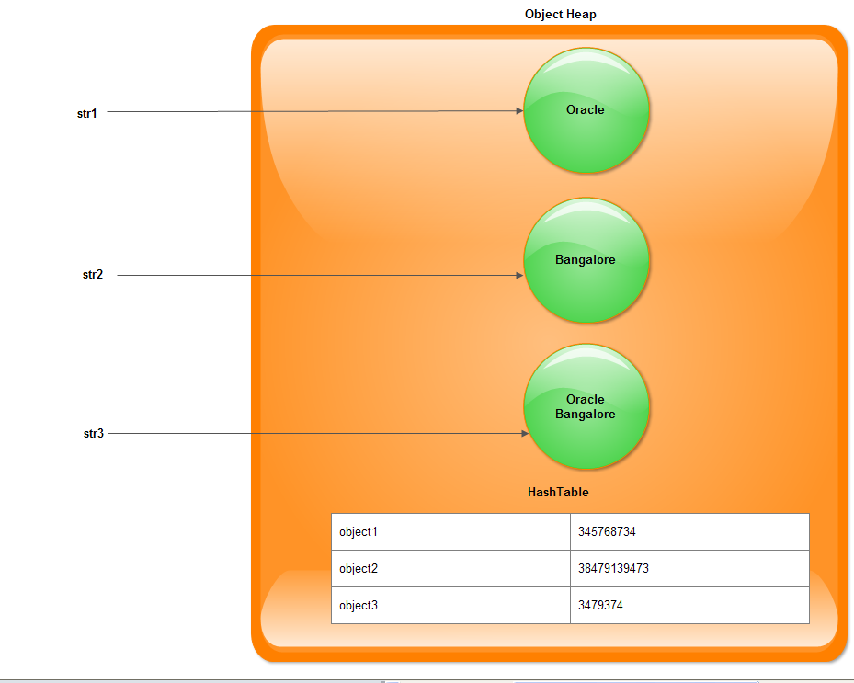

Slide 14
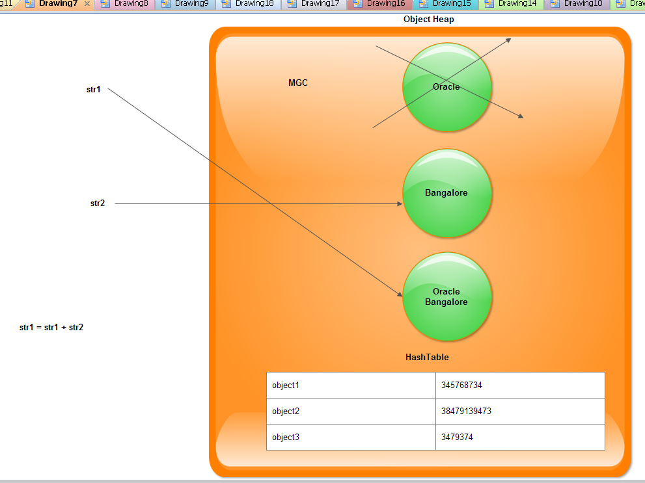

Slide 15
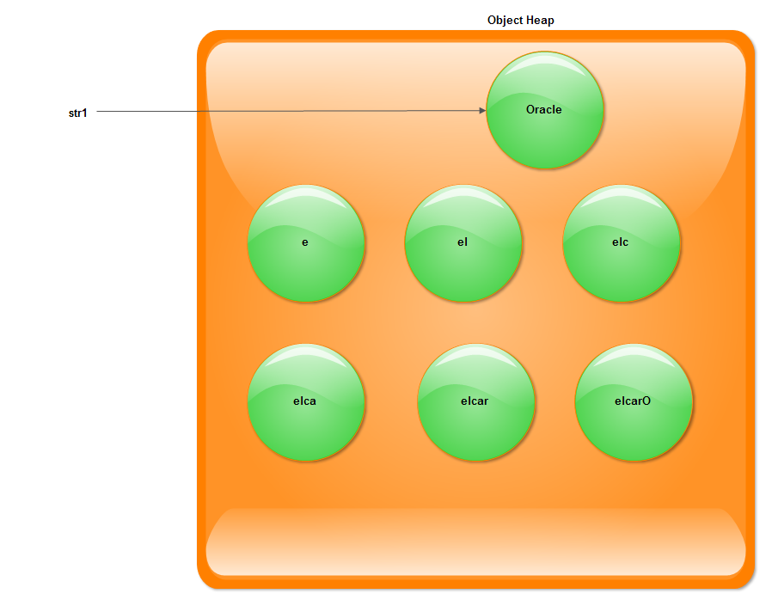

Slide 16
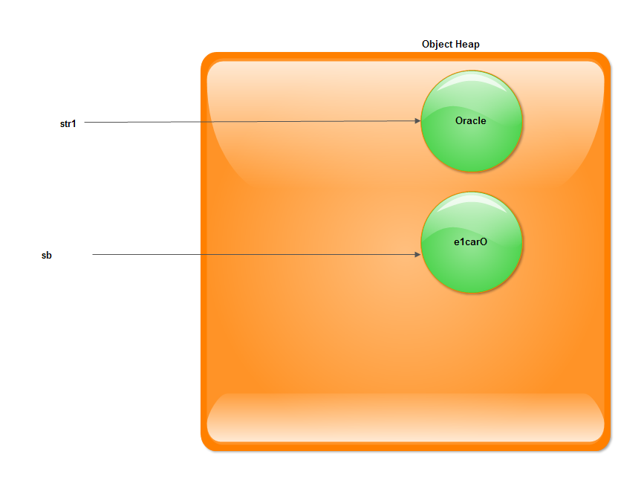

Slide 17
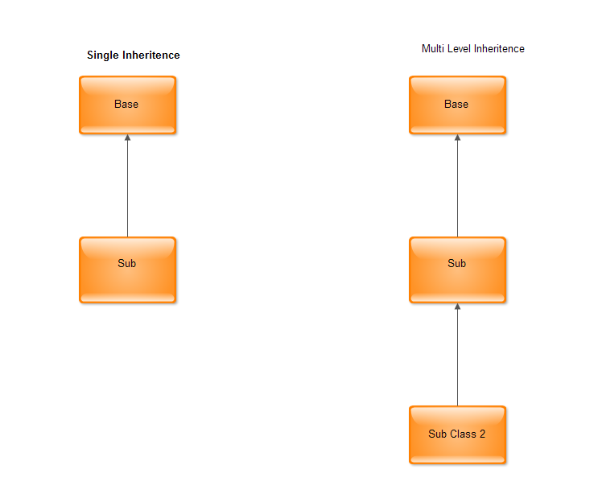

Slide 18
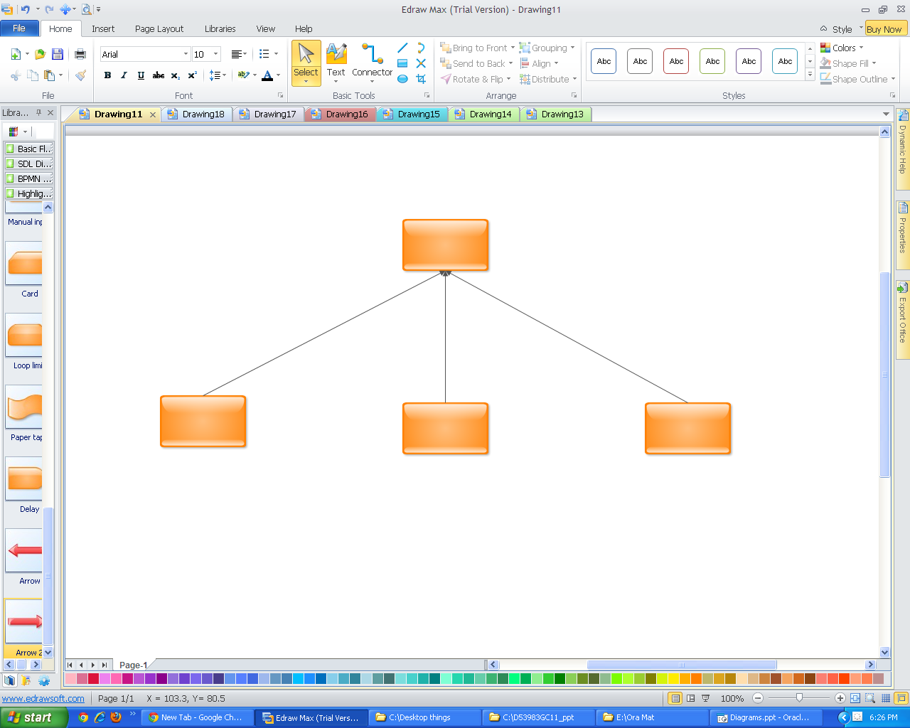

Slide 19
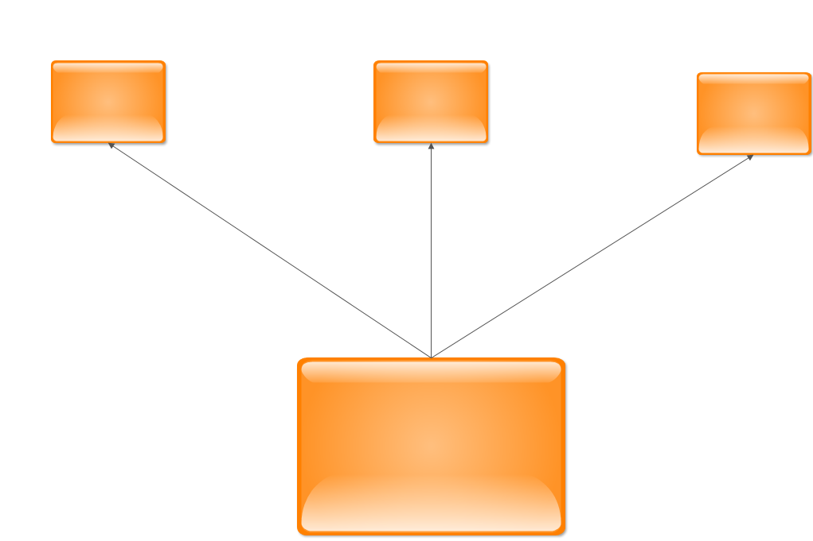

Slide 20
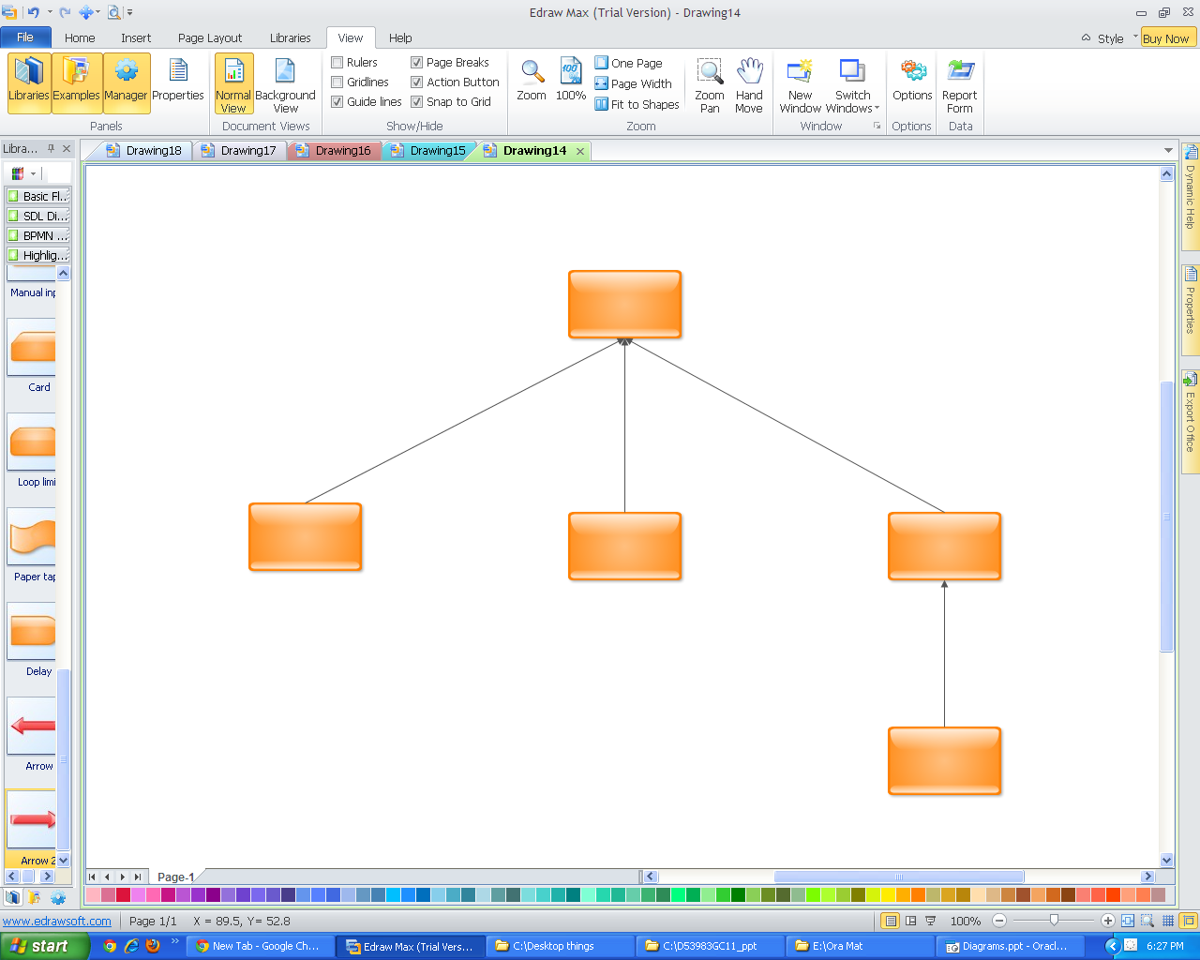

Slide 21
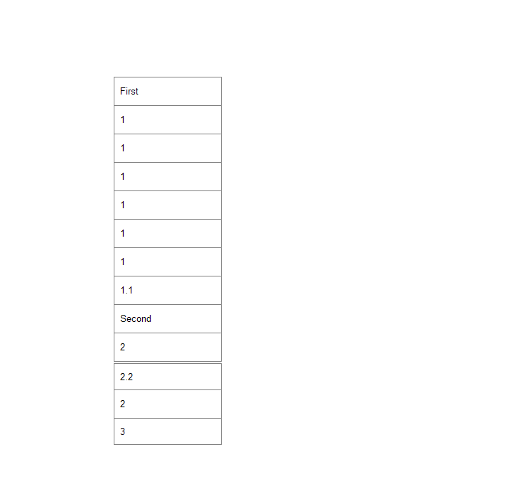

Slide 22
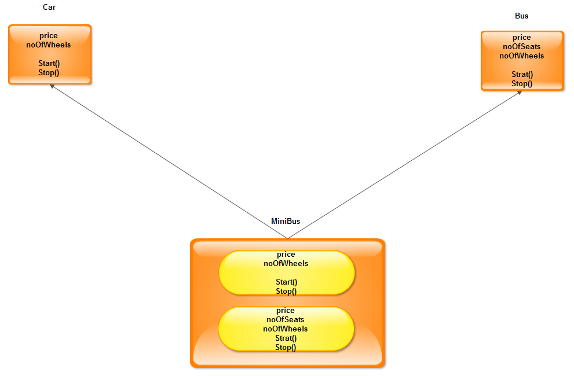

Slide 23
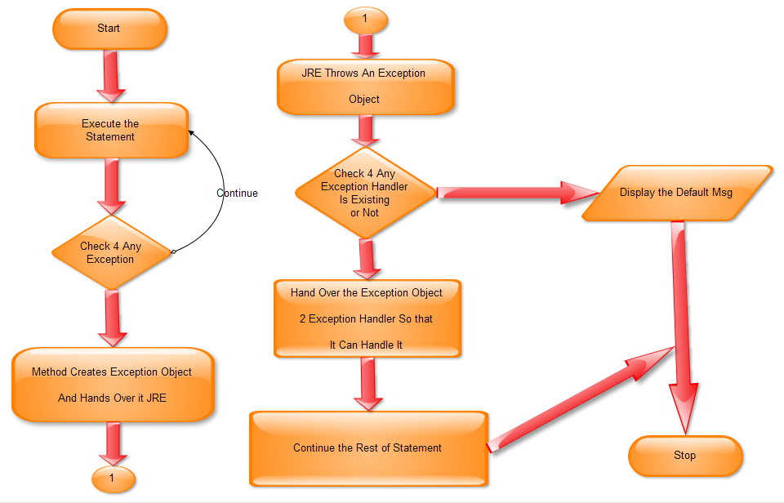
NO
NO
Yes
Yes

Slide 24
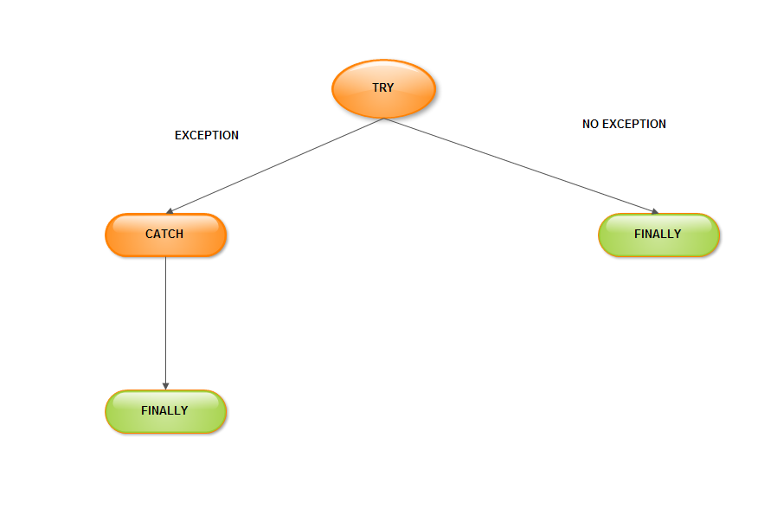

Slide 25
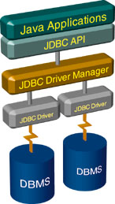
Architecture and Querying With JDBC
Connect
Query
Process results
Close

Slide 26
Stage 1: Connect
Connect
Register the driver
Query
Connect to the database
Process results
Close
Notes:
The first thing you need to do is establish a connection with the DBMS (Database Management System) you want to use. This involves two steps:
loading the driver and
making the connection.
Now, we shall first see as to what is a JDBC Driver.

Slide 27
Stage 2: Query
Connect
Query
Create a statement
Process results
Query the database
Close
Notes:
Once a connection is established, it is used to pass SQL statements to its underlying database.
A Statement object is used to send SQL statements to a database. The Statement interface provides basic methods for executing statements and retrieving results.
The JDBC API does not put any restrictions on the kinds of SQL statements that can be sent; this provides a great deal of flexibility, allowing the use of database-specific statements or even non-SQL statements. It requires, however, that the user be responsible for making sure that the underlying database can process the SQL statements being sent and suffer the consequences if it cannot. For example, an application that tries to send a stored procedure call to a DBMS that does not support stored procedures will be unsuccessful and will generate an exception.

Slide 28
Stage 3: Process the Results
Connect
Query
Step through the results
Process results
Assign results to Java variables
Close
Notes:
Now that we have obtained the results of querying the database in the ResultSet object, we need to iterate through this object and retrieve its contents for further processing in the Java program.

Slide 29
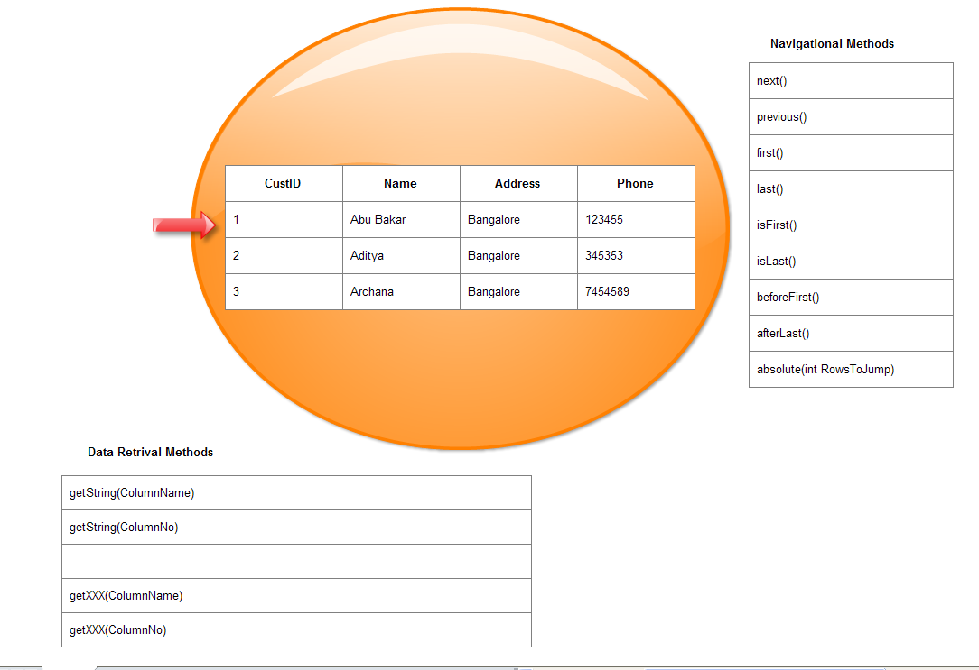

Slide 30
Stage 4: Close
Connect
Query
Close the result set
Process results
Close the statement
Close
Close the connection
Notes:
Normally, nothing needs to be done to close a ResultSet object; it is automatically closed by the Statement object that generated it when that Statement object is closed, is re-executed, or is used to retrieve the next result from a sequence of multiple results. The method close is provided so that a ResultSet object can be closed explicitly, thereby immediately releasing the resources held by the ResultSet object. This could be necessary when several statements are being used and the automatic close does not occur soon enough to prevent database resource conflicts.

Slide 31
DriverManager
Connection
DatabaseMetaData
Statement
ResultSet
ResultSetMetaData
Notes:
Summary of JDBC Classes
DriverManager
DriverManager provides access to registered JDBC drivers. DriverManager hands out connections to a specified data source through its getConnection() method.
Connection
The Connection class is provided by the JDBC driver, as are all subsequent classes mentioned. A Connection object represents a session with a database and is used to create a Statement object, using Connection.createStatement().
Statement
The Statement class executes SQL statements. For example, queries can be executed using the executeQuery() method and the results are wrapped up in a ResultSet object.
ResultSet
JDBC returns the results of a query in a ResultSet object. A ResultSet object maintains a cursor pointing to its current row of data. The next() method moves the cursor to the next row. The ResultSet class has getXXX() methods to retrieve the columns in the current row.
DatabaseMetaData and ResultSetMetaData
The DatabaseMetaData and ResultSetMetaData classes return metadata about the database and ResultSet, respectively. Call getMetaData() on the Connection object or the ResultSet object.

Slide 32
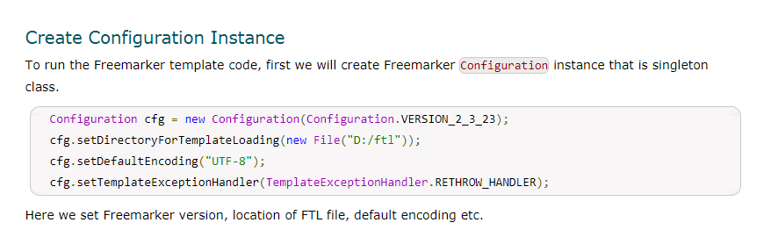

Slide 33
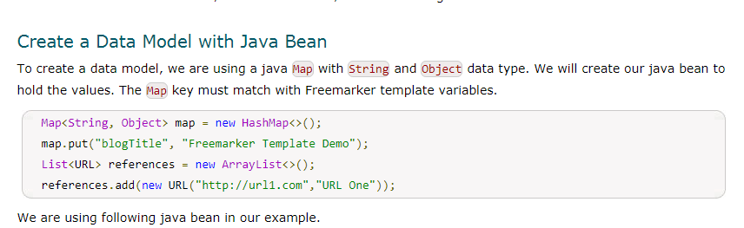

Slide 34
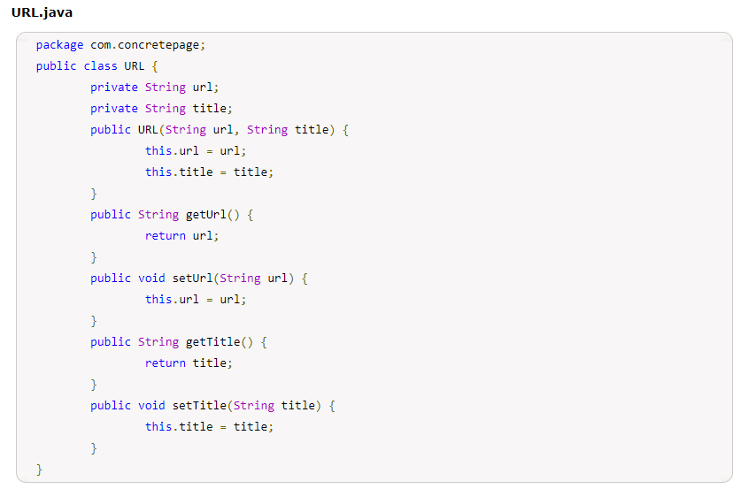

Slide 35
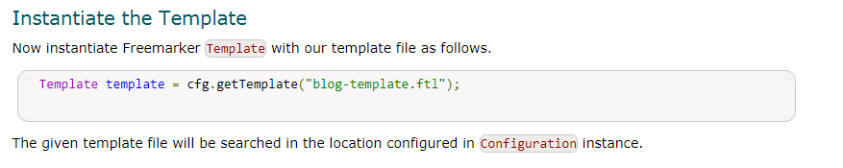

Slide 36
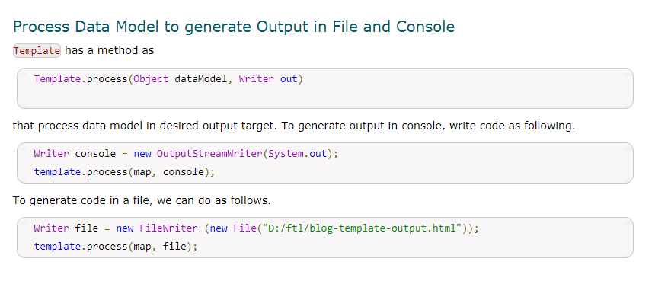

Slide 37
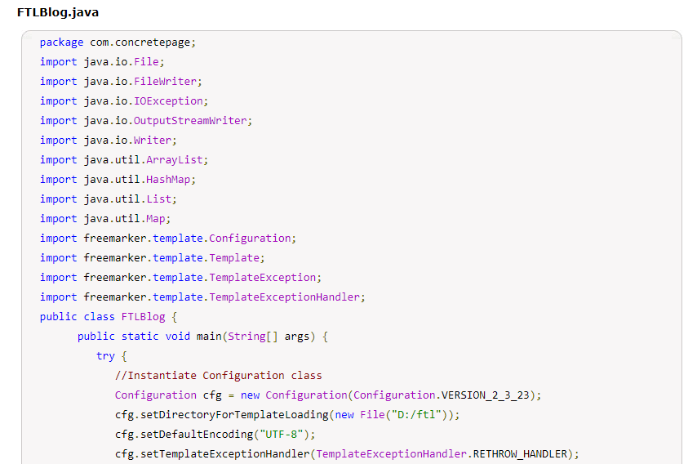

Slide 38
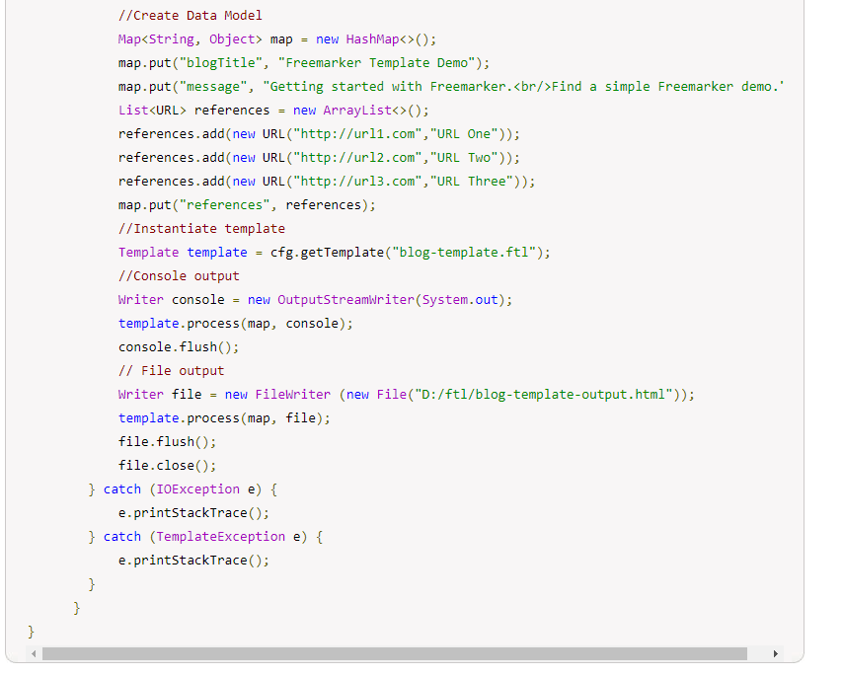

Slide 39
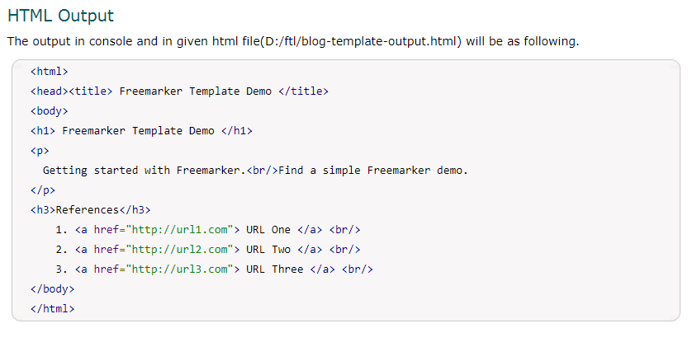

Slide 40
Enumeration & Iterator

